Slide 1
The Pandemic and the Economy
Summer 2020
Fiscal Policy Response
Nancy Kimelman

Slide 2
Lecture Outline
Fiscal Policy Defined
Monetary Policy Defined
CARES ACT Provisions
GAO Report Card

Slide 3
FISCAL POLICY
Defined
Government measures undertaken to manipulate the level and allocation of taxes and government expenditures with the goal of stabilizing the economy.
Examples:
  Change in capital gains tax rate
  Change in marginal income tax brackets
  Change in corporate income tax rates
NOT Examples:
  Change in bank marginal reserve requirements
  Change in the central bank’s interest rate target
The line between fiscal and monetary policy has been blurred during the pandemic as the Fed has taken on the role of administering certain aspects of the CARES Act.

Slide 4
Monetary Policy Defined
Measures undertaken by a nation’s central bank to stabilize the economy by changing the rate of growth of money and reserves with the purpose of influencing interest rates, asset prices, the exchange rate, and bank lending.
Examples:
  Change in the overnight bank lending rate
  Change in the rate of growth of high powered money
  Purchases and sales of Treasury and nonTreasury securities in the open market
NOT Examples:
  Changes made away from the central bank, e.g. lowering tax rates

Slide 5
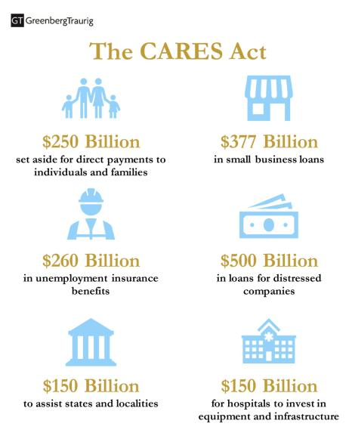
The
CARES ACT

Slide 6
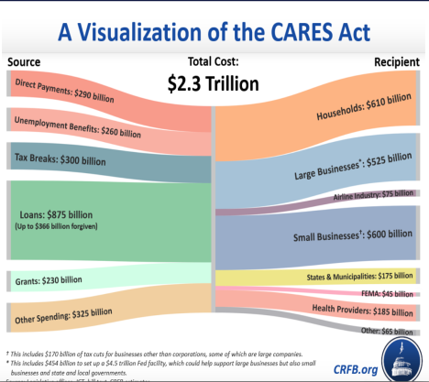
The
CARES ACT

Slide 7
direct income support
CARES ACT COMPONENTS
In the U.S., every adult and child in the U.S. received a one-time check from the federal government, subject to income limits. Adults received $1200 and children $600, so long as income was below $75,000 for individuals and $150,000 for married couples.

Slide 8
direct income support
CANADA
Canada Emergency Response Benefit (CERB)
Temporary income support for workers who have stopped working or are earning less than $1,000 (before taxes) in a month due to COVID-19. It provides a payment of $2,000 for a 4-week period for up to 16 weeks.
Canada Child Benefit (CCB)
Eligible individuals who are presently receiving the Canada child benefit (CCB) will continue to receive these payments based on their 2018 tax return information in the event their required 2019 income tax return is not assessed by September 2020. Canadians who normally receive the CCB got a one-time payment increase of an extra $300 for each child on May 20, 2020.
Canada Emergency Student Benefit (CESB)
Temporary financial support for eligible post-secondary students and graduating high school students who are unable to work due to COVID-19.

Slide 9
direct income support
JAPAN
One-time 100,000 Yen (roughly $900) payment to everyone who has resided in Japan for at least three months and is registered as a basic resident as of April 27, 2020.
No income limits
Requires an application.

Slide 10
Paycheck protection
Cares Act
The Paycheck Protection Program (PPP), a provision of the CARES Act, offers forgivable, low-interest loans to small businesses facing uncertainty during the COVID-19 emergency,. Its goal is to allow small business owners to so retain workers, maintain payroll, and cover certain other existing overhead costs.
The idea is straightforward: keep employees afloat until the economy is back, and keep employers in business so employees have jobs to return to.

Slide 11
Paycheck protection
Canada
A Canadian employer whose business has been affected by COVID-19 is eligible for a subsidy of 75% of employee wages for up to 12 weeks, retroactive from March 15, 2020, to June 6, 2020.
This wage subsidy is designed to enable firms to re-hire workers previously laid off as a result of COVID-19, help prevent further job losses, and better position the employer to resume normal operations following the crisis.

Slide 12
Paycheck protection
Japan
Japanese law requires businesses to pay furloughed employees 60 percent of their wages.
Japanese companies have a very different attitude towards layoffs than in the U.S., for a variety of economic and social reasons.

Slide 13
Help for unemployed
CARES ACT
Pandemic Unemployment Assistance – New program to provide unemployment benefits for people who don’t usually qualify for regular state Unemployment Insurance.
Pandemic Emergency Unemployment Compensation – A 13-week benefit extension for people who have used all benefits available in their regular Unemployment Insurance claim.
Pandemic Additional Compensation – An additional $600 federal stimulus payment automatically added to each week of benefits received between March 29 and July 25, 2020.

Slide 14
Tax RELIEF FOR INDIVIDUALS
CARES ACT
Waives the 10% early withdrawal penalty for 401K and IRA distributions up to $100,000. Withdrawals are still taxed, but taxes are spread over three years, or the taxpayer has the three-year period to roll it back over.
Employer payments to an employee for schooling are excludable from income of the employee.
Tax deadline extended to July 15
401K loan limit raised to $100,000. And forced distributions suspended.
Interest expense limitations increased to 50% from 30% for tax years beginning in 2019 or 2020.

Slide 15
Tax RELIEF FOR businesses
CARES ACT
Eligible employers are entitled to a credit against the employer’s share of the Old-Age, Survivors, and Disability Insurance (OASDI) employment taxes (6.2 percent rate) for each calendar quarter equal to 50 percent of the qualified wages for the quarter.
Delay of payment of employer payroll taxes
The restriction of 80% on carryforward losses has been eliminated.
The list goes on….

Slide 16
Small business loans
CARES ACT
In addition to the PPP…
  Economic Injury Disaster Loan: This loan offers relief to small businesses and non-profits that are currently experiencing a temporary loss of revenue.
  SBA Express Bridge Loans: Enables small businesses who already do business with an SBA Express Lender to gain quick access up to $25,000.
  SBA Debt Relief: SBA will pay 6 months of principal, interest, and fees that borrowers owe for all current SBA loans and Microloans.
  The Federal Reserve assumed responsibility for the Main Street Lending Program in the CARES Act. It will be discussed in the next lecture.

Slide 17
Small business loans
CARES ACT
In addition to the PPP…
  Economic Injury Disaster Loan: This loan offers relief to small businesses and non-profits that are currently experiencing a temporary loss of revenue.
  SBA Express Bridge Loans: Enables small businesses who already do business with an SBA Express Lender to gain quick access up to $25,000.
  SBA Debt Relief: SBA will pay 6 months of principal, interest, and fees that borrowers owe for all current SBA loans and Microloans.

Slide 18
large business help
CARES ACT
$500 billion allotted to provide loans, loan guarantees, and other investments; these loans are overseen by a Treasury Department inspector general. These loans cannot be forgiven.
Airlines will receive $50 billion (of the $500 billion) for passenger air carriers, and $8 billion for cargo air carriers.
FYI: Unknowingly (??), large businesses qualified and received moneys under the small business program. The amounts total to 75% of all monies allotted.

Slide 19
Other provisions
CARES ACT
Moneys awarded to hospitals and health care organizations to help them cope with the overload. These funds are for supplies, worker compensation, accelerated Medicare payments, facilities, drug research, testing, etc.
State and local government got federal funds to help reverse the shortfall in tax revenue due to Covid 19.
Agricultural bailout.

Slide 20
Congress General Accounting Office review
CARES ACT
HHS Took Action but Experienced Substantial Challenges with Its Initial COVID-19 Public Health Response
For example:
As of May 31, 2020, HHS expended about $65 billion to provide funding to providers, such as hospitals, to respond to COVID-19, according to the department. This includes funding for Medicare providers, as well as providers heavily impacted by COVID-19; rural health care providers; skilled nursing facilities; and Indian Health Service, tribal, and Urban Indian facilities.
CDC allocated about $12.1 billion for awards to state, local, territorial, and tribal organizations as of May 31, 2020, according to agency officials. Of this amount—about $10.3 billion—is to support COVID-19 testing nationwide.
CDC awarded the remaining $1.8 billion to these entities to support activities, including COVID-19 surveillance, epidemiology, laboratory capacity, infection control, mitigation, communications, and other preparedness and response activities.
As of May 31, 2020, HHS reported obligations of about $3.612 billion to support treatments or vaccines for COVID-19, of which about $18 million had been expended.
CDC reported data that were not complete.
CDC reported data that were not consistent.

Slide 21
General Accounting Office review
CARES ACT
Read it yourself…
https://www.gao.gov/reports/GAO-20-625/#TOC_Letter_Findings

Slide 22
references
I used a variety of web sites accumulating information for these slides, including the US Treasury, Congress, the National Law Review, GAO, Brookings, Forbes….
The CARES Act was a work in progress even after passage. Regrettably, some of the information I read and used may be incorrect. If you let me know, I will fix it immediately.
I am solely responsible for this content.

